Slide 1
RDU4 MADE at Amazon Program
Objective: To celebrate and recognize associates who consistently contribute to a positive work environment, enhance customer experiences, strengthen team collaboration, and uplift morale through outstanding performance, acts of kindness, and shared success.

Slide 2
RDU4 MADE at Amazon Program
Framework

Slide 3
Weekly Initiatives
Shout-out Board: A physical or digital space where associates can recognize coworkers who have gone above and beyond.
Mini-Spotlights: Managers select one associate per department to highlight in team meetings.
Peer Recognition Cards: Associates can write quick “thank you” notes to each other, fostering a culture of appreciation.
Station Pass: Associate will receive a Station Pass that will allow the associate a one-time opportunity to move to a station for path of choosing.

Slide 4
Monthly Initiatives
M.A.D.E. at Amazon: Nominate and recognize associates who have shown exemplary dedication. Categories within Amazon Leadership Principles.
Team Building Activity: Encourage engagement through themed events like “Pizza & Praise” or “Coffee & Kudos.”
Social Media Feature/Newsletter: Highlight outstanding associates on internal communication platforms.

Slide 5
Quarterly Initiatives
Recognition Luncheon: A small event to celebrate top-performing associates, featuring certificates or small gifts.
Manager’s Choice Recognition: Leaders select associates who’ve demonstrated commitment beyond their role.
Impact Stories: Share stories of how recognized employees have influenced the workplace positively.

Slide 6
Annual Initiatives
Associate of the Year Award: Recognizing the most impactful associate with an award and additional perks (gift card, extra day off, etc.).
Leadership Development Opportunity: Offer professional development rewards such as mentorship programs or training sessions for top contributors.
Give Back Event: Organize a community service event with recognized associates leading the initiative.

Slide 7


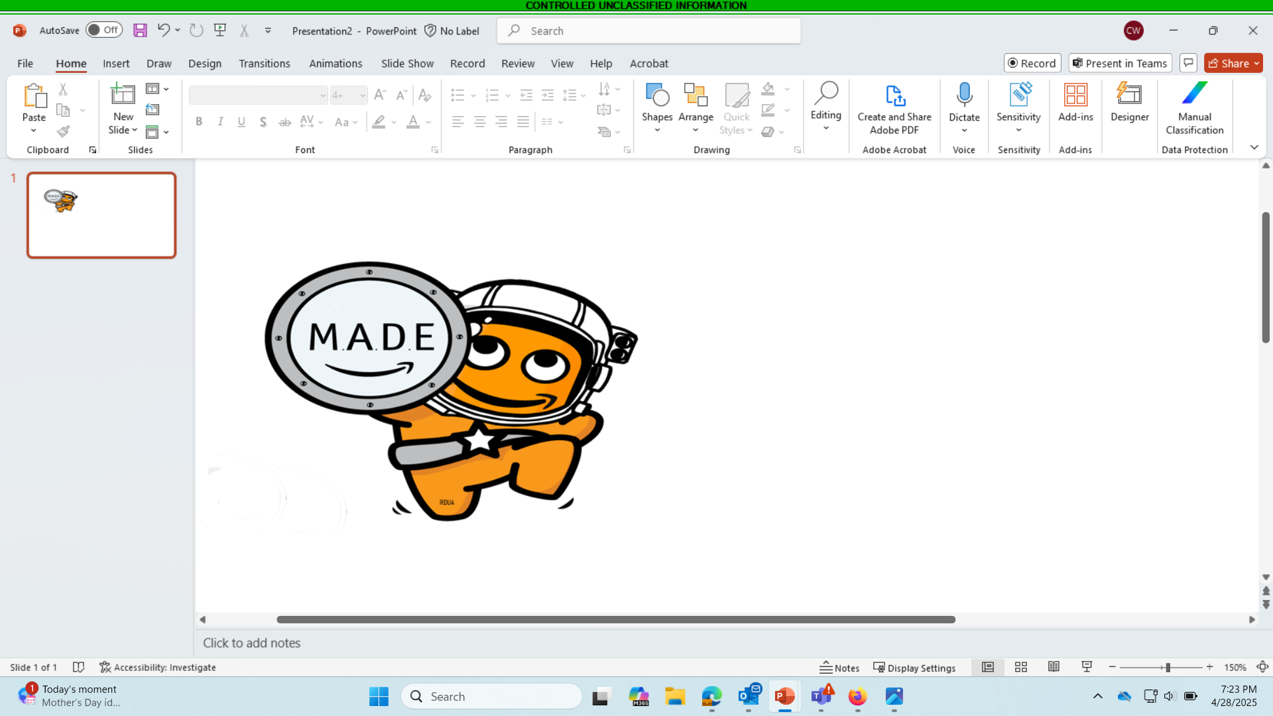

M.A.D.E.
at AMAZON!
Customer Obsession
Ownership
Invent and Simplify
Are Right, A lot
Learn and Be Curious
Hire and Develop the Best
Insist on the Highest Standards
Think Big
Bias for Action
Frugality
Earn Trust
Dive Deep
Have Backbone, Disagree and Commit
Deliver Results
Strive to be Earth’s Best Employer
Success and Scale Bring Broad Responsibility
RDU 4
M.A.D.E Making A Difference Everyday at AMAZON!

Slide 8

M.A.D.E Making A Difference Everyday at AMAZON!
RDU 4
I made a Difference at RDU 4!
“Ownership”
Joe Peccy
BHD Dock

Slide 9
Making A Difference Everyday
I made a Difference at RDU 4!
“Ownership”
Joe Peccy
BHD Dock
at AMAZON!

Slide 10
1st Quarter
2nd Quarter
3rd Quarter
4th Quarter
RDU 4
Joe Peccy
BHD IB
Joe Peccy
PXT
Joe Peccy
PXT
Joe Peccy
PXT
RDU 4 Wall of Fame
Monthly
Monthly
Joe Peccy
FHD IB
Joe Peccy
BHD IB
Joe Peccy
FHD OB
Joe Peccy
BHD OB
Joe Peccy
Safety
Joe Peccy
PXT
Joe Peccy
FHN IB
Joe Peccy
BHN IB
Joe Peccy
FHN OB
Joe Peccy
BHN OB
Joe Peccy
Safety
Joe Peccy
PXT

